Slide 1
Shujuku Hackers
Calvin Qiao, Chris Cortez, Austin Wang, Tatum Tu

Slide 2
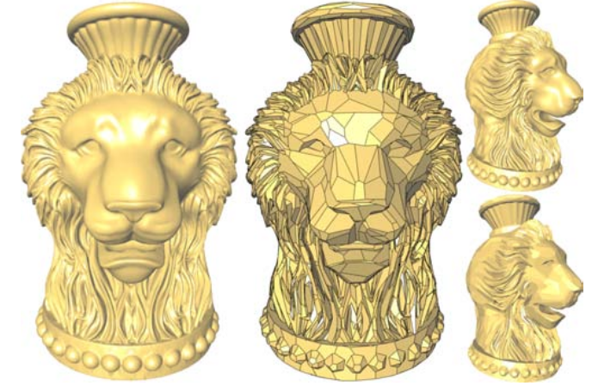
Project Goal
Develop and test the algorithm from the paper “Variational Shape Approximation”
A framework for geometric approximation of surfaces to reduce the computational cost of graphics
Using the concept of geometric proxies, we drive the distortion error down through repeated clustering
Image source: “Variational Shape Approximation”

Slide 3
Data Structures
Polygonal Mesh Class
Unordered map of polygons
Proxy Class
Parameters of proxy planes
List of assigned polygons
Priority Queue
Heap of polygons
...
PolygonalMesh
Class
...
Proxy
Class
...

Slide 4
Algorithm Breakdown
Load STL file
Partition the Surface using Flooding
Fit Partitions to Proxies
Extract Proxies into Mesh/STL
Loyds Clustering Algorithm
(k-means)
Re-partition the Surface

Slide 5
Initial Task Assignment
Implement Proxy class
Austin, Calvin
Implement the Initial Partition Algorithm
Tatum
Implement Loyds Clustering Algorithm
Austin, Calvin
Convert Final Proxy class to output mesh
Chris

